Slide 1
Game Design Masterclass
Group 9: Douglas Simpson, Thomas Simmons, Quwaine Dantes, Callam Mutton

Slide 2
The Brief
The brief given is to create a 2d game for a mobile platform.
It must be multiplayer, and controlled via a single button press.
It must be symmetric, with both players having the same options and controls.
It can be simultaneous or turn based.

Slide 3
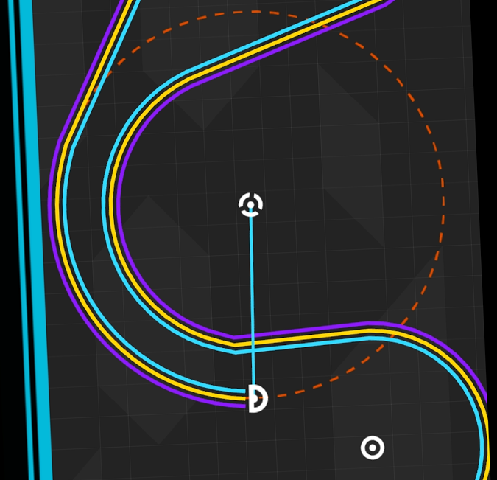
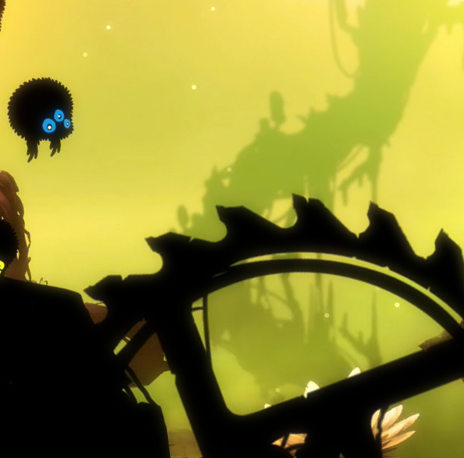
Research
Having looked at the example games along with several others, we got a few ideas on how many ways a single button input can be used:
One More Line: The button is used as a toggle here. Movement is constant but the direction altered dependant on when the button is pressed and for how long.
Badland / 2: Here, the player falls constantly, something that’s countered when the button is pressed. This can be used to affect the players movement path, with obstacles or puzzles along the way.

Slide 4

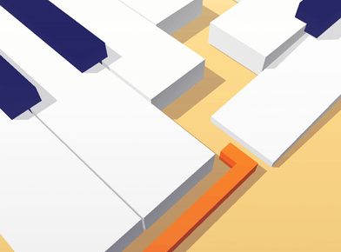
Research
Stack: Here, the timing of the button press is key. When it’s pressed determines how well you do. However, this has another use. It could be used to give the player more options if it also affected the players control-a constantly scrolling list could have an option selected by a single button press.
Dancing Line: This used other aspects of the game (specifically Audio in this case) to inform the player as to when they should use their single input.

Slide 5
Game Ideas
Roulette Fighter
Gravity Line
Sub Game

Slide 6
Roulette Fighter
Simultaneous
A simple 2d fighting game
Moves are selected by stopping a spinning wheel-Thus the game would be timing and skill based.
Possible casino theme for the visuals
Core Loop: Wheel spins, Player selects move, move resolves
Hard Fun/People Fun

Slide 7
Gravity Line
Turn Based (But could be simultaneous)
Heavily inspired by One More Line
Gravity would be used to direct the swinging players
Would be a downhill time trial race
Core Loop: Player falls, Player collects and swings, Player releases
Hard Fun/Serious Fun/People fun (if it was simultaneous)

Slide 8
Sub Game
Simultaneous
Each player controls a submarine
Tapping causes it to dive and fire a torpedo across the screen
Various obstacles such as seaweed that would slow movement, mines that detonate when hit and sand on the bottom that obscures vision when hit.
Core Loop: Player taps to position themselves, Torpedoes are launched, Players attempt to evade.
Hard fun/People fun

Slide 9
Chosen Idea
We’ve chosen to go with the Sub Game
Should be possible to put together in the limited time for the project and team skillset.
Lots of options for obstacles and possible unlockable submarines.
We will be creating it in Unreal 4

Slide 10
Any Questions?

